Slide 1
ASPIRE Resources and Communications

Slide 2
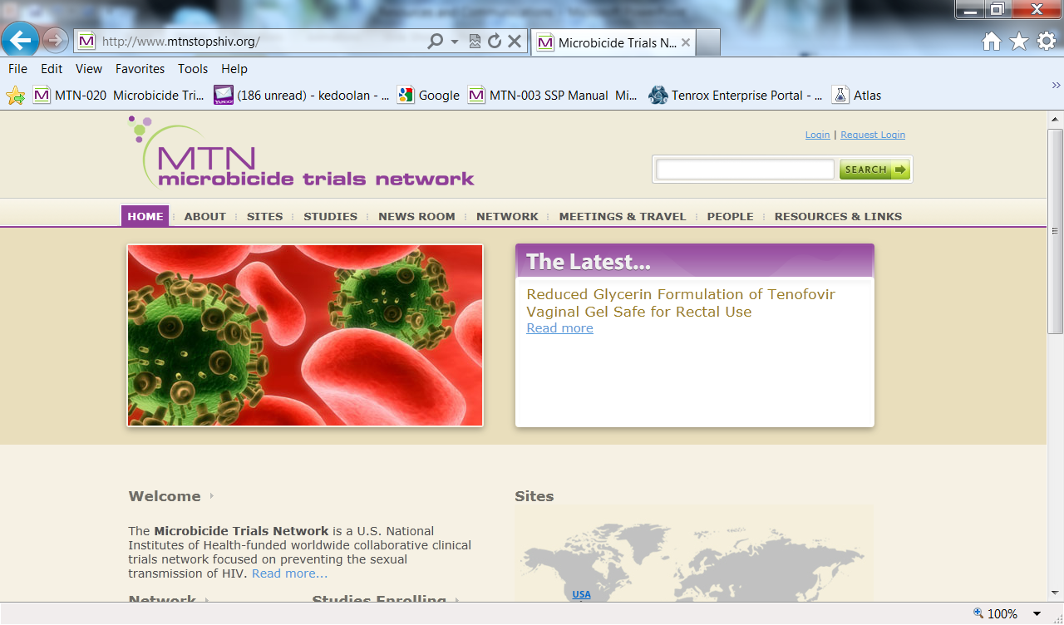
MTN Website
http://www.mtnstopshiv.org/

Slide 3
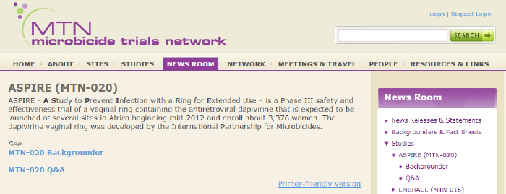
MTN Website
Studies → to get to ASPIRE’s webpage (or for any other protocol)
Newsroom → from MTN communications, ASPIRE page: http://www.mtnstopshiv.org/news/studies/mtn020

Slide 4
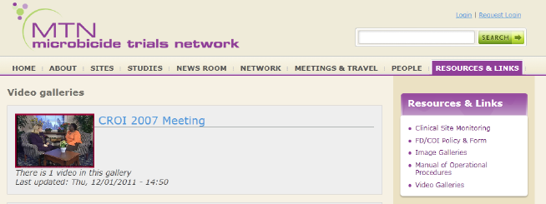
MTN Website
People → look up specific people, who is on a particular alias list
Resources and Links → MTN MOP, training videos (see particularly OSOM rapid trich test training video

Slide 5
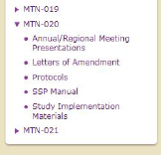
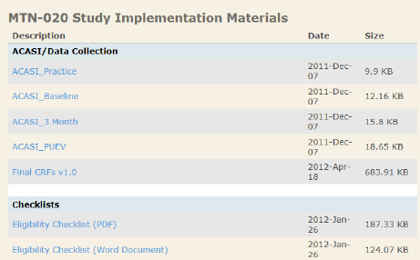
ASPIRE Website
http://www.mtnstopshiv.org/studies/3614
Notes:
Current versions of all templates available here.

Slide 6
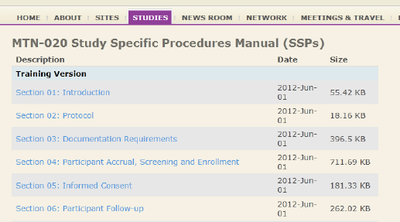
ASPIRE Website
http://www.mtnstopshiv.org/studies/3614
Save time!
CTRL-F to find guidance you’re looking for easily…
Notes:
Current versions of all templates available here.

Slide 7
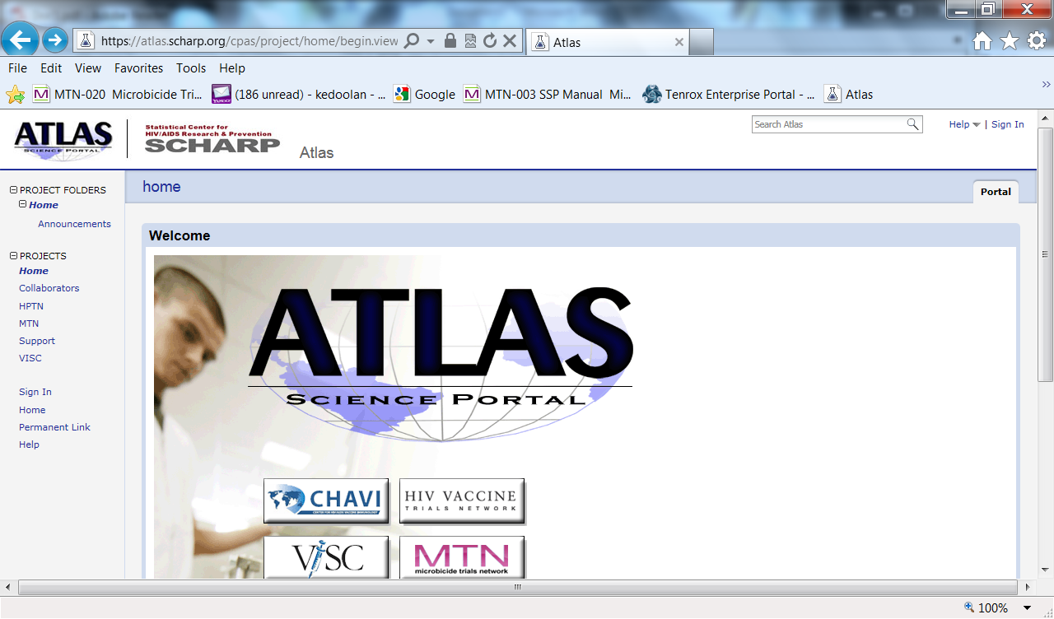
Atlas portal
https://atlas.scharp.org/cpas/project/home/begin.view

Slide 8
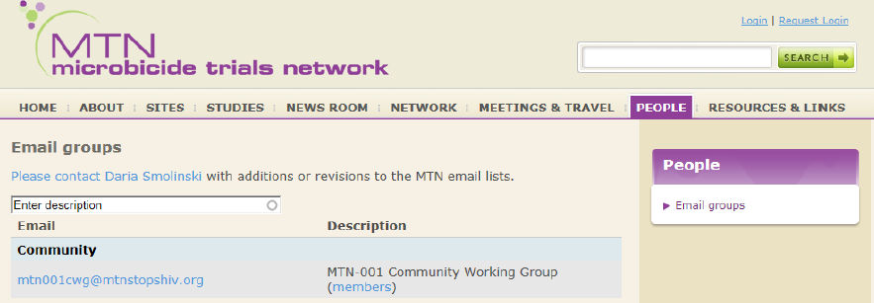
Site-to-site communications
Alias lists for each staff cadre (IoR, study coordinator, clinicians, outreach, counselors, lab, pharmacy)
Please remember to let FHI know if staff members on these lists need to be updated

Slide 9
Alias lists and team communication
mtn020mgmt@mtnstopshiv.org
Who: Chairs, NL, pharmacy, FHI 360, SCHARP, MTN regulatory, MTN regional physician
mtn020safetymd@mtnstopshiv.org
Who: Katie, Devika and Ken
mtnregulatory@mtnstopshiv.org
Who: Regulatory personnel at Pitt-CORE
mtnnetworklab@mtnstopshiv.org
Who: Ted, Lorna, Wayne and Charlene

